Slide 1

Impulse Excitation
Technique
NDT Technologies Applications
by
Paul Bosomworth
President/CEO
BuzzMac International, LLC
Contact Info
Email: paul@buzzmac.com
Ph: +1 (603) 835-3180

Slide 2
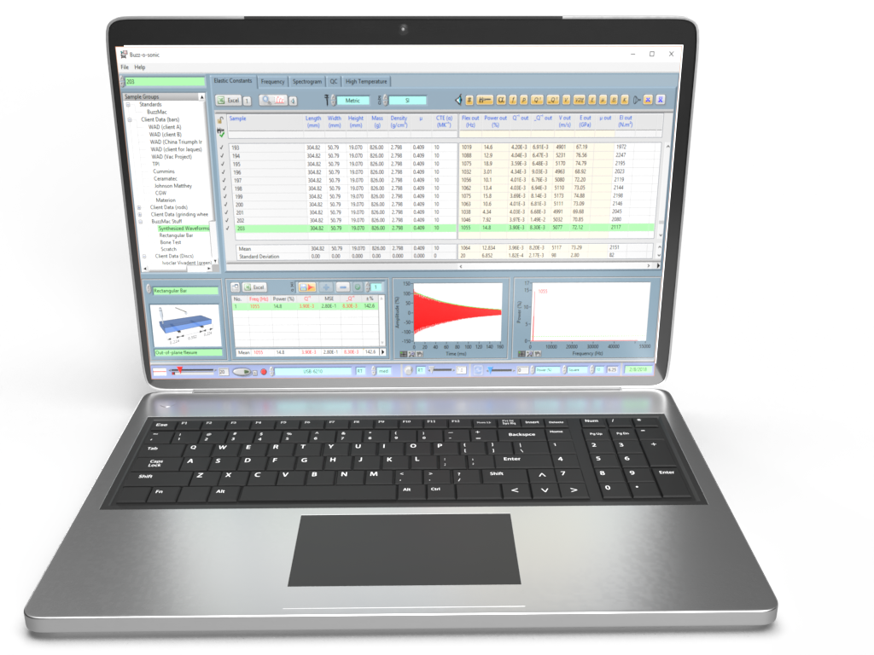
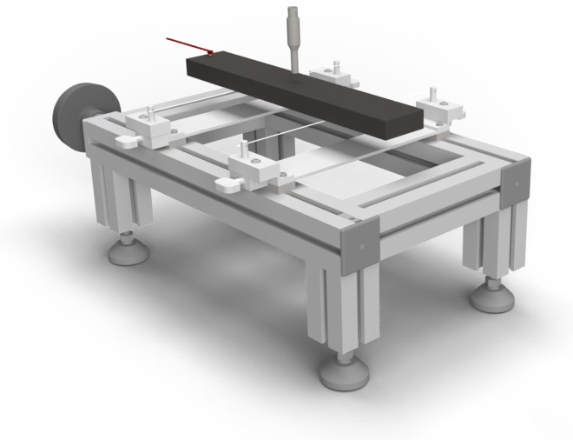


Impulse Excitation Technique (IET)*
TAP
SAMPLE
MEASURE
VIBRATIONS
RECORD & ANALYSE
(damping/elastic properties)
*also known as ping test, resonant vibration, impact acoustic resonance, eigen frequency method…

Slide 3
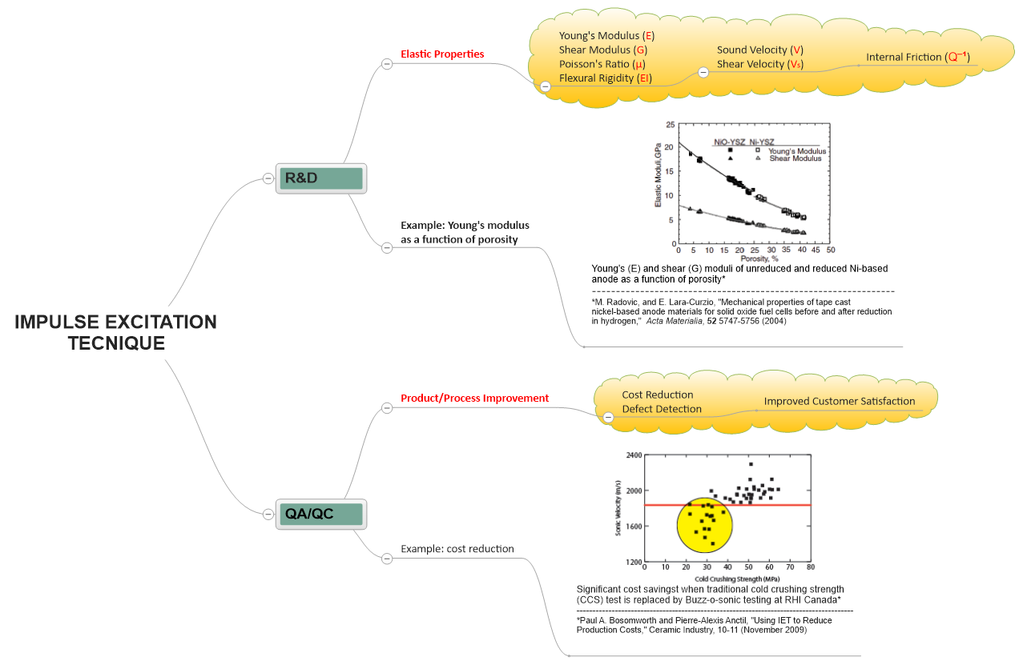
Research
Development
Quality Control
Process Control
Cost Saving
COMPLIES WITH ASTM E1876 & C1259…

Slide 4
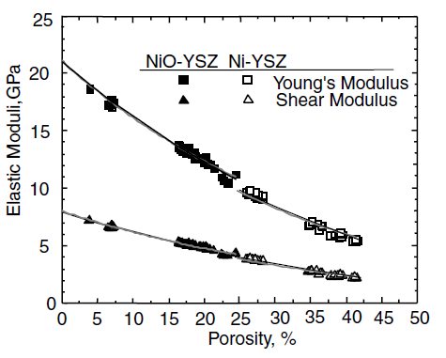
Research & Development: Example 1
Young’s Modulus of Tape-cast SOFC Anode Vs. Porosity
A study¹ conducted by M. Radovic and E. Lara-Curzio of the Metals and Ceramics Division, Oak Ridge National Laboratory, used the Buzz-o-sonic testing system to measure the Young's and shear moduli of some tape cast nickel-based anode materials for solid oxide fuel cells. Approximately one half of the samples were reduced in 4% H₂ and 96% Ar gas mixture at 1000 °C for 30 minutes.
Young's (E) and shear (G) moduli of unreduced and reduced Ni-based anode as a function of porosity
An exponential and a composite sphere model (CSM) were used to fit the data to the porosity (gray and black solid lines respectively)
¹M. Radovic, and E. Lara-Curzio, "Mechanical properties of tape cast nickel-based anode materials for solid oxide fuel cells before and after reduction in hydrogen," Acta Materialia, 52 5747-5756 (2004)

Slide 5
Research & Development: Example 2
Monitoring Elastic Properties During Firing
Green extruded cylinder of a quartz-porcelain mixture fired to 1100°C¹
Unfired (green) ceramics can be tested using IET and the changes in elastic properties monitored during firing.
NOTE: Elastic properties can also be monitored during hydration and other processes because the test is nondestructive
¹ P. A. Bosomworth, " Monitoring the Elastic Properties of Green Ceramics during Firing," Ceramic Industry (February 2016) &
Igor Stubna, Frantisek Chmelık, Anton Trnık, Peter Sin, “Acoustic Emission Study of Quartz Porcelain during Heating up to 1150°C,” Ceram. Int., 38 6919–6922 (2012)

Slide 6
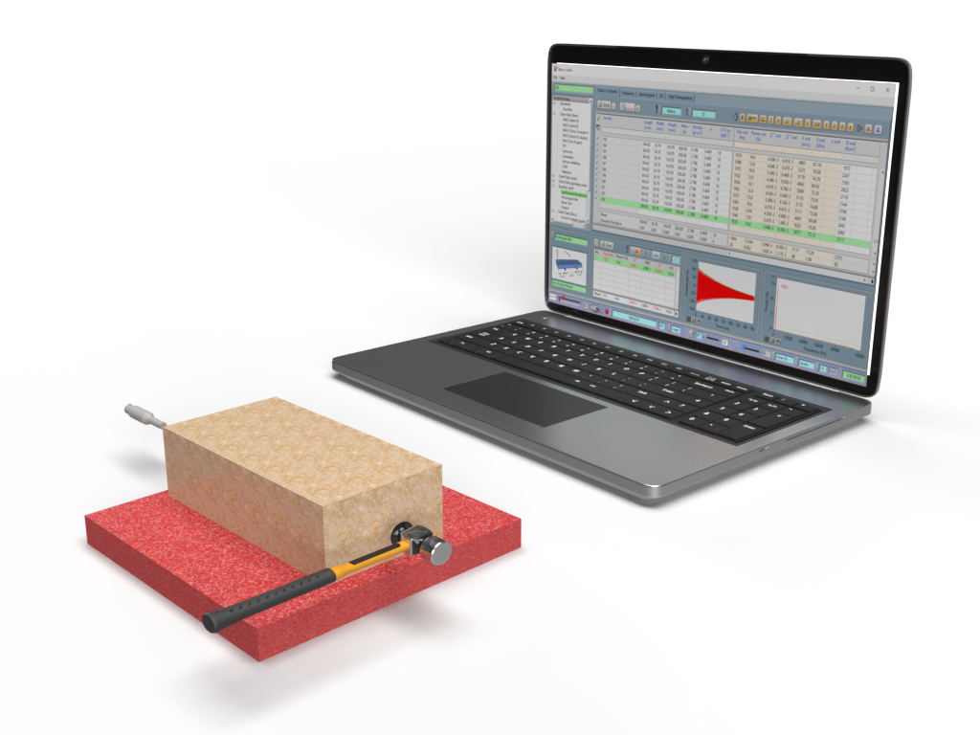
Quality Control
Reducing Production Costs of Magnesite-Chrome Brick¹
Sonic velocity = 2 x length x frequency
Low strength population that we want to identify
Cold crushing strength testing is a much slower and therefore a more expensive test than sonic velocity testing using IET
¹ Paul A. Bosomworth and Pierre-Alexis Anctil, "Using IET to Reduce Production Costs," Ceramic Industry, 10-11 (November 2009)

Slide 7
Conclusions and Comments
IET is ideally suited to measuring the elastic and damping properties of ceramics, metals and polymers…
IET can be used over a variety of testing environments (high/low temperatures, humidity…)
IET is fast, efficient and relatively low cost compared to destructive mechanical testing
IET is suited to R&D, QC/QA, cost reduction…
Any question or comments, please contact me on linkedin.com/in/paul-bosomworth-78151514

